Slide 1
3nd Task of your Project
„All you have to decide, is what to do with the time that is given to you.“
J.R.R. Tollkin
Prof. Dr. Christian Bleis
1
Interaktionskompetenz

Slide 2
Content
Mechanism of Planning (Part III)
GANTT
CPM (Critical Path Method)
…

Slide 3
What did you till now? (1st Step)
Mechanism of Planning (I)
Start with the essence (short summary) of what you are trying to do
Postulate the end result of your project (When are you “satisfied” with your Project?)
List all possible tasks that needed to be done to reach the goal(s)
Draw a WBS that shows and groups the tasks to be done ➔ “Architecture”
Draw a flow chart and examine the dependencies of the tasks (PERT)
Prepare a ppt-Presentation for tomorrow morning?
Prof. Dr. Christian Bleis
3
Interaktionskompetenz

Slide 4
Next (3nd) Step
Mechanism of Planning (II)
Estimate work packages (people, time (GANTT) etc.)
Examine the “critical path”
Define the monitoring indicators (➔ be SMART)
Identify possible risks
Iterate plan
Document & Monitor
Prof. Dr. Christian Bleis
4
Interaktionskompetenz

Slide 5
Five good bets to make your project a story of success!
1. A clear project work plan is essential for balancing time, cost, and quality.
2. Make the projects objectives + targets, management task + work packages, timelines and resource allocation clear to every member of the project team.
Prof. Dr. Christian Bleis
5
Interaktionskompetenz

Slide 6
Five good bets to make your project a story of success!
3. First and Foremost: Always remember MURPHY’s Law! (Brooke’s Law: Adding stuff to late to the project just makes it later!)
Prof. Dr. Christian Bleis
6
Interaktionskompetenz

Slide 7
Project Tool
(3) Gantt
Prof. Dr. Christian Bleis
7
Interaktionskompetenz

Slide 8
Gantt diagramm
A Gantt Chart is a tool used for scheduling projects, events or personal milestones or goals.
It is created to show the order of actions (tasks) that must be done before a project can be considered complete.
Henry Gantt, a mechanical engineer, invented the Gantt chart in the 1910s. He designed his chart so that production foreman could watch schedules to ensure the work was being done on time. Gantt charts were used when building the Hoover Dam and for organizing large projects.
Interaktionskompetenz

Slide 9
How to create a GANTT-Diagram?
- It just takes 7 Steps -
Prof. Dr. Christian Bleis
9
Interaktionskompetenz

Slide 10
Creating a Gantt-diagram in 7 Steps
Step 1
Think in reverse.
Interaktionskompetenz

Slide 11
Creating a Gantt-diagram in 7 Steps
Step 1
Think in reverse.
The first step is to decide what task must be completed last and what task must be completed first.
Interaktionskompetenz

Slide 12
Creating a Gantt-diagram in 7 Steps
Step 1
Think in reverse.
The first step is to decide what task must be completed last and what task must be completed first.
Then decide what task cannot be completed until another task is done.
Tasks that cannot be started until another is complete are known as interdependency tasks.
Interaktionskompetenz

Slide 13
Creating a Gantt-diagram in 7 Steps
Step 2
Decide if a simple or complex Gantt chart is needed.
Interaktionskompetenz

Slide 14
Creating a Gantt-diagram in 7 Steps
Step 2
Decide if a simple or complex Gantt chart is needed.
A simple Gantt chart contains columns for the task, responsible person and dates before completion.
Interaktionskompetenz

Slide 15
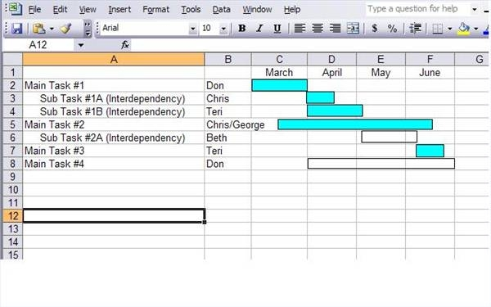
Gantt diagramm
Interaktionskompetenz

Slide 16
Creating a Gantt-diagram in 7 Steps
Step 2
Decide if a simple or complex Gantt chart is needed.
A simple Gantt chart contains columns for the task, responsible person and dates before completion.
A complex chart can include those columns plus
start and end dates,
number of days
it will take to complete the task,
that have elapsed,
sub-tasks and percent complete.
Interaktionskompetenz

Slide 17
Creating a Gantt-diagram in 7 Steps
Step 3
Put the task name in the left-most column (one task per row),
the responsible person's name in the second column and
arrange the remaining columns by month, day or week.
For a complex chart, include columns for
percentages or other information deemed important
for tracking the project..
Interaktionskompetenz

Slide 18
Creating a Gantt-diagram in 7 Steps
Step 4
Draw a line or hollow box to show the expected length of time each task will take, lining up the box under the appropriate start and end dates.
Consider the interdependency tasks and arrange them underneath each other and under their main task.
Stand-alone tasks can be adjusted throughout the project life for the best use of resources and time.
Interaktionskompetenz

Slide 19
Creating a Gantt-diagram in 7 Steps
Step 5
Remember to allow flexibility in your project time-line.
If the final due date is July 30th, it is generally a good idea to plan its completion 2 – 3 days earlier. This allows for the possibility of employee illness or another unplanned event.
Interaktionskompetenz

Slide 20
Creating a Gantt-diagram in 7 Steps
Step 6
Color in the task indicated on the chart as it is completed or use a different color to indicate the task is not finished yet. The date of completion may be added to the chart, if so desired.
If the project is long, the manager may consider small celebratory steps along the way in order to encourage employees to stay on track.
Interaktionskompetenz

Slide 21
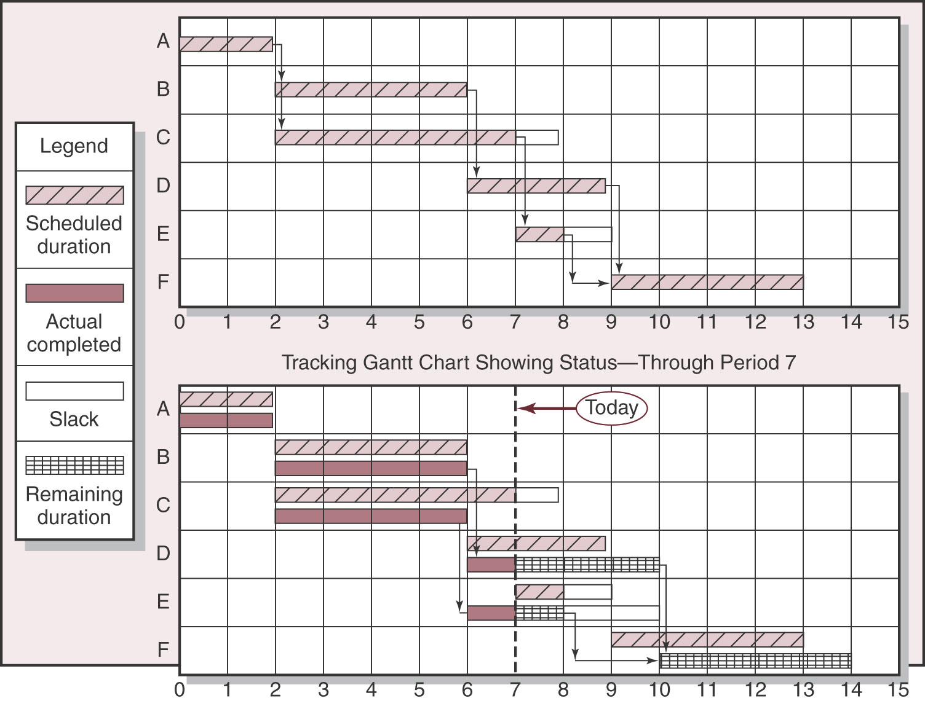
Gantt diagram
Prof. Dr. Christian Bleis
21
Interaktionskompetenz

Slide 22
Creating a Gantt-diagram in 7 Steps
Step 7
Review the time-line regularly (such as daily) to ensure the projects tasks are being completed in a timely manner.
If the project is running behind schedule, rearranging tasks might be necessary.
Conversely, if the project is ahead of schedule, rearrange some tasks that might be more difficult to ensure meeting the original deadline.
Interaktionskompetenz

Slide 23
Gantt diagram
Prof. Dr. Christian Bleis
23
Interaktionskompetenz

Slide 24
Differences between Gantt + PERT Charts (I)
Project managers commonly use both Gantt and PERT, charts to display tasks required for task scheduling and project completion. A main difference between Gantt Charts and PERT charts is that:
Gantt is a bar chart, while
PERT is a flow chart.
They are probably the best-known project management charts.
Interaktionskompetenz

Slide 25
Differences between Gantt + PERT Charts (II)
Time vs. Relationships
Gantt charts emphasize the time it takes to complete tasks,
while PERT charts emphasize relationships between tasks.
Interaktionskompetenz

Slide 26
Differences between Gantt + PERT Charts (II)
Linear vs. Interconnecting
a Gantt chart is linear. (Any relationships between tasks on a Gantt chart are depicted with arrows.)
while
a PERT chart shows an interconnecting network of tasks
Interaktionskompetenz

Slide 27
Differences between Gantt + PERT Charts (III)
Limitations
Project managers often use both types because
Gantt charts do not effectively illustrate the dependency of one task upon another, while
PERT charts can be complicated and confusing.
Interaktionskompetenz

Slide 28
Differences between Gantt + PERT Charts (III)
Straightforward vs. Complex
PERT charts often are designed for only parts of projects.
Gantt charts, on the other hand, work well for more straightforward projects that most likely will not require mid-stream changes.
Interaktionskompetenz

Slide 29
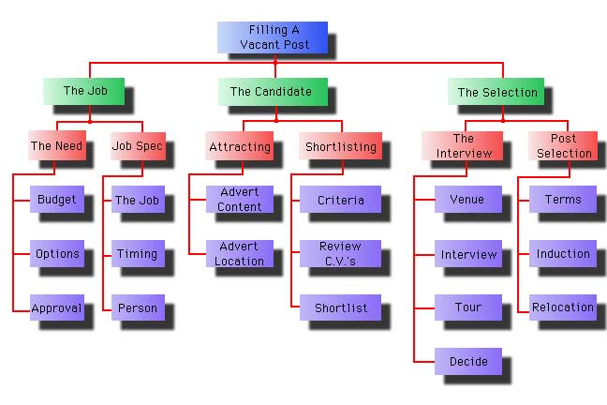
An Example (recruitment of a new person to fill a vacant post)
Below is a work breakdown structure for the recruitment of a new person to fill a vacant post.
Prof. Dr. Christian Bleis
29
Interaktionskompetenz

Slide 30
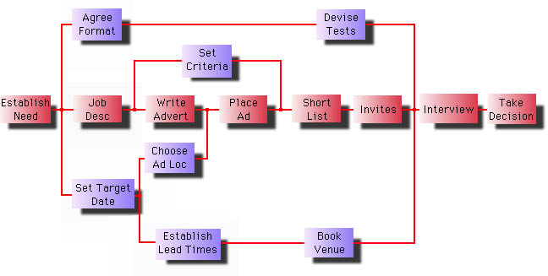
An Example (recruitment of a new person to fill a vacant post)
Below is the PERT chart of the WBS shown above after network analysis has been applied.
Prof. Dr. Christian Bleis
30
Interaktionskompetenz

Slide 31
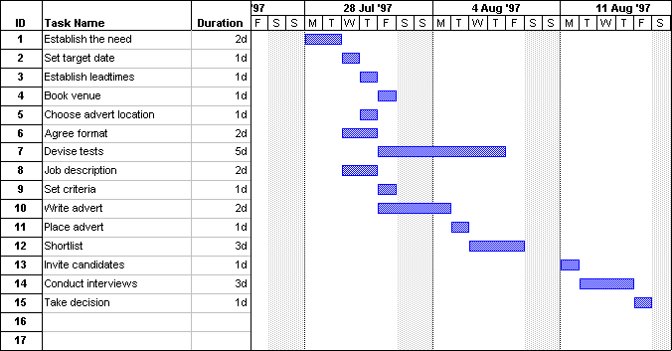
An Example (recruitment of a new person to fill a vacant post)
The PERT chart above is now displayed as a Gantt chart below
Prof. Dr. Christian Bleis
31
Interaktionskompetenz

Slide 32
Your Project
Prof. Dr. Christian Bleis
32
Interaktionskompetenz

Slide 33
Chose one Project for your own!
Planning an International Congress (5.000 €, 2 Persons)
Organizing a „Surprise Party“ for your … (100 €, 2 Persons)
Organizing the „Golden Wedding-party“ for your parents (2.500 €, 2 Persons)
2 Girls cooking in one Kitchen a 7-course-diner (100 €, 2 Persons)
Constructing and building of a Pool table (100 €, 1 Person)
… or whatever comes to your mind
Prof. Dr. Christian Bleis
33
Interaktionskompetenz

Slide 34
Chose one Project for your own!
Choose a project
Plan it with the approptiate steps of planning
Presentate the results (via ppt-presentation) by using the Project controlling tools (WBS, PERT, CPM, GANTT)
Have fun ;-))
Prof. Dr. Christian Bleis
34
Interaktionskompetenz

